Slide 1
Rail Lift (R-Lift)
Iemec Project, Presented by:
André Saldanha nº 78148
Tomás Macedo nº 79002
Tomás Costa nº 79713

Slide 2
Rail Lift (R-Lift)
Garbage duct?
What should we do?
Is this a good idea?
What do they think about this?
Should we discuss this with someone else?

Slide 3
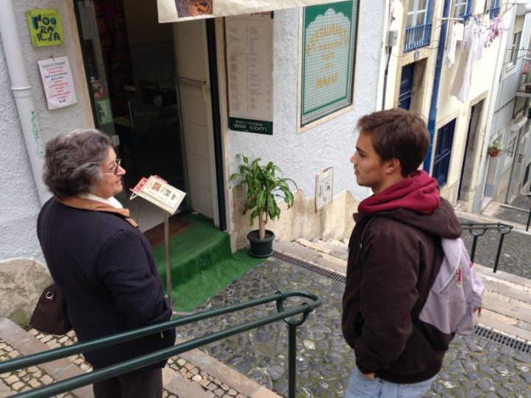
Rail Lift (R-Lift)
We went over to Mouraria in order to undestand a little more about what the people from there needed to improve their lifestyle.

Slide 4
Rail Lift (R-Lift)
LETS DO A RAIL LIFT!!
But what is a rail lift after all?

Slide 5
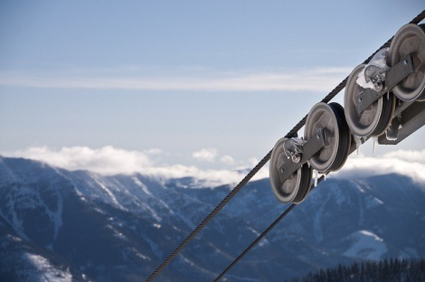
Rail Lift (R-Lift)
Is electricity needed for the R-LIFT to work?
How does it work?
Is it safe?

Slide 6
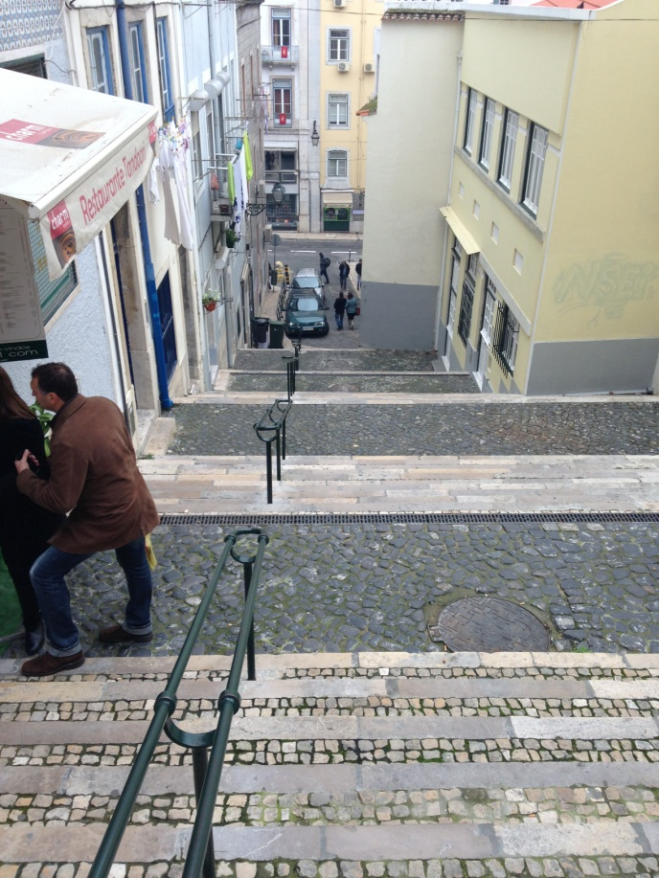
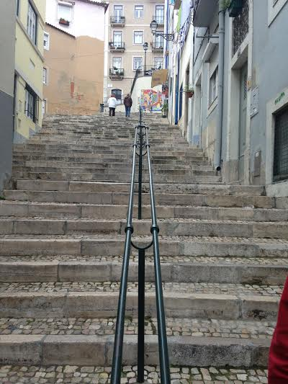
Rail Lift (R-Lift)
And where would we put this rail lift?
Beco dos Surradores / Poço do Borratém
(Perto do largo Martim Moniz)

