Slide 2
MEEA – IST Musicleta Group: Carlos Gomes Emile Arinaga 14 de Novembro de 2013

Slide 3
Goals
Motivate people to use free fitness installations
Measure people’s health
Provide useful information to residents
Teach residents the benefits of having a healthy heart and a good fitness condition
Increases cooperation & safety in neighborhood

Slide 4
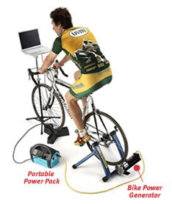
The Bicycle
Bicycle in a steady support
Whell linked to an alternator
Alternator charging a 12V battery
Battery used to power the
music device

Slide 5
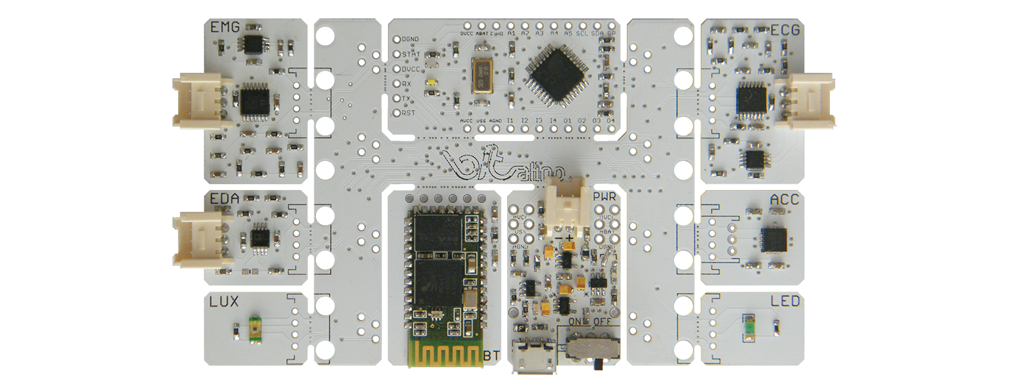
Sensing your Body
Electrocardiogram sensors
Connected to Bitalino
Output displayed on laptop with installed software OR smartphone/tablet with installed app.

Slide 6
The Athlete’s Grade
3
2
1.5
1
0.5
0.1
0
Impossible
Superb Athlete
A
$$\frac{RPM}{BPM}=$$
Great Sportsman
B
A
Hard Worker
C
Could Use a Little More Work
D
Needs Improvement
E
Faster you pedal + Lower your Heart Rate is = Better grade

Slide 7
Database

Slide 8
Human Computer Interaction

Slide 9
Goal
Transfer information understandable and meaningful for public audiences

Slide 10
Simplicity
Usability
Learnability
Predictability

Slide 11
Rotation Per Minute
Heart Beats Per Minute
ECG Graphic
Timer
Grade
Information about health

Slide 12
Musicleta
Evaluate yourself
and keep track of
your condition!
someone@musicleta.pt
password
SIGN IN
Can’t Access Your account?
Not Registered? Do it now!

Slide 13
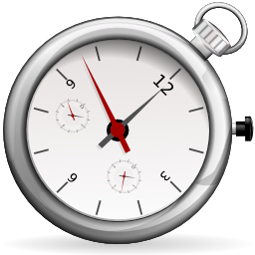
00:00
How many rotations are you pedaling per minute (RPM)
000
How many times your heart beats per minute (BPM)
Your life starts here!
BEGIN
000
Musicleta

Slide 14
00:43
How many rotations are you pedaling per minute (RPM)
132
How many times your heart beats per minute (BPM)
155
Fitness Tips
Health And Diet Tips
Fun facts about your heart
Musicleta
END

Slide 15
00:43
How many rotations are you pedaling per minute (RPM)
< Go Back
132
Health and diet tips
--Drink plenty of water or other calorie-free beverages
--Think about what you can add to your diet, not what you should take away.
--Eat several mini-meals during the day.
--Stock your kitchen with healthy convenience foods
--Use non-food alternatives to cope with stress
--Be physically active
How many times your heart beats per minute (BPM)
155
Musicleta

Slide 16
00:43
How many rotations are you pedaling per minute (RPM)
< Go Back
132
Fun facts about your heart
-- Every day, the heart creates enough energy to drive a truck 20 miles. In a lifetime, that is equivalent to driving to the moon and back
--The average adult heart beats 72 times a minute; 100,000 times a day; 3,600,000 times a year; and 2.5 billion times during a lifetime
--The heart begins beating at four weeks after conception and does not stop until death
--Prolonged lack of sleep can cause irregular jumping heartbeats called premature ventricular contractions
--Some heavy snorers may have a condition called obtrusive sleep apnea (OSA), which can negatively affect the heart
How many times your heart beats per minute (BPM)
155
Musicleta

Slide 17
00:43
How many rotations are you pedaling per minute (RPM)
< Go Back
132
Fitness Tips
--Start Running
--Exercise with a friend
--Set Goals and Rewards
--Weigh Yourself weekly
--Enjoy Cheat meals
--Have fun & stay positive
How many times your heart beats per minute (BPM)
155
Musicleta

Slide 18
Subject: Emile Arinaga
TIME FINISHED!!!
Pedals
91
Evaluation Sheet
Name | Emile Arinaga
Previous Grade | C
Today’s Grade | B
Conclusion | Congratulations Emile, You’re getting better, you are becoming a great sportsman
Heart
114
WARNING! This is not a certified machine that can replace a
profissional doctor’s exam, we are not experts on the subject,
if you ever feel sick, contact your doctor immediatelly or call 911
Musicleta

