Slide 1
Project Lux Andante
The light that moves with you
Utilizing LED technology and sensors
Pedro Guerreiro
MEEA 2013-2014

Slide 2
The challenge
(@ Mouraria)
Many streets
Many lights on
Few people
Notes:
The challenge
Observe important challenges arround the city
Many small streets
During the night, lights are on
Few people on the streets
> Represents a waste of energy consumption (and costs and emissions)
So why not trying to reduce this?

Slide 3
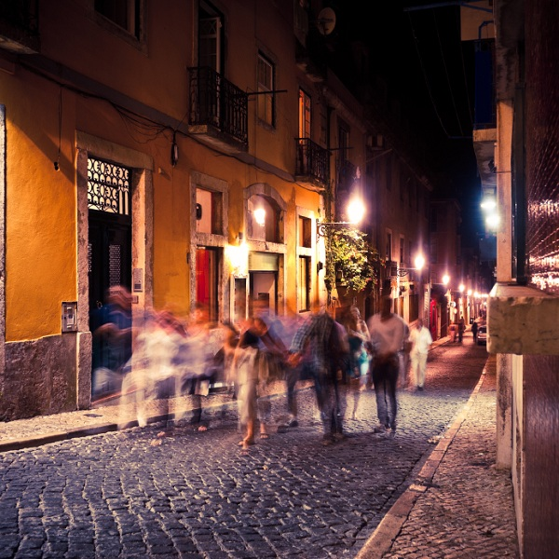
The concept
Energy Eficiency
LED technology
Moving sensors
Notes:
The concept
The “Lux Andante” concept is a very simple idea to improve energy eficiency of public light systems. It uses:
LED technology (saves from 50 to 70% of consumption, long lifetime and it has dimmering capability)
Moving sensors (get an extra 10% of savings – saves in total 80% of energy consumption)
But…
… in order to apply this concept it will require not only a great investment efford and savings promises but also convince mentalities, starting with the people itself and the government officials.
I believe the best way to do so, is to get people well informed. That is why, I design a strategy to tackle this problem and create awareness in people and officials about this technologies.

Slide 4
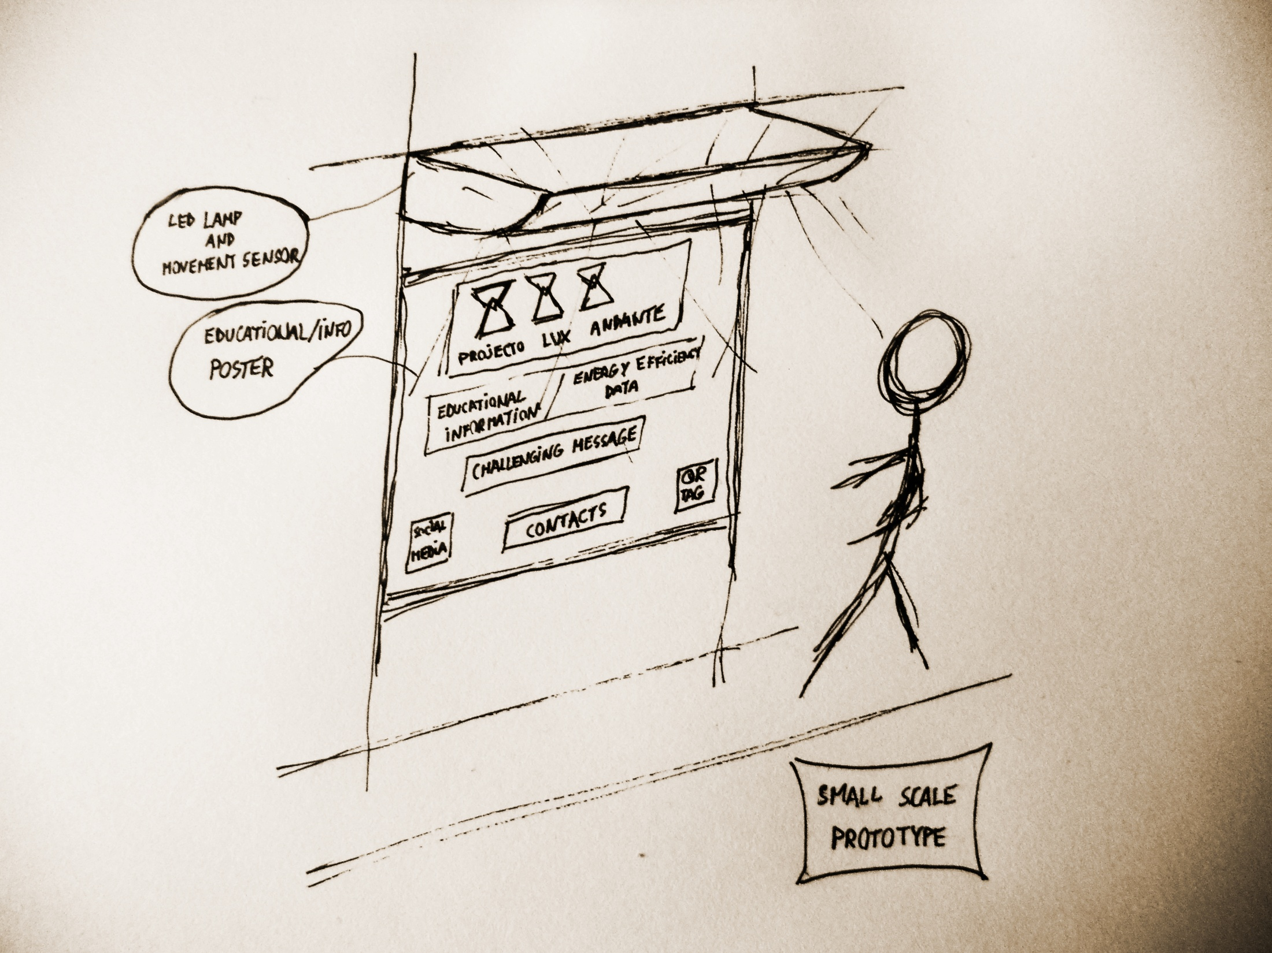
The prototype strategy
The prototype strategy
Notes:
The Prototype Strategy
Because of the issues mentioned in the previous slide (convince mentalities), I proposed the following prototype/pilot strategy, the Lux Andante Sidewalk
Lux Andante Sidewalk
Works as the same way as the concept on the previous slide, i.e., as the person walks, a movement sensor will trigger the full bright light. When on “standby” mode, the lights will be dimmered to a lower brighter value, and in this case, it will light a mood and multi color system.
Apart from that, this sidewalk will be excelent to inform and experience the project (on the left). Nevertheless, this can also be very attractive as a publicity platform for sponsors and others (center and banner), and even to create interactive displays (right).
Since it will be out of the budget doing na entire sidewalk, I decided to do a low budget (arround 50€) part of it: the small scale prototype.
This can be devided into two parts:
The lamp system
The poster

Slide 5
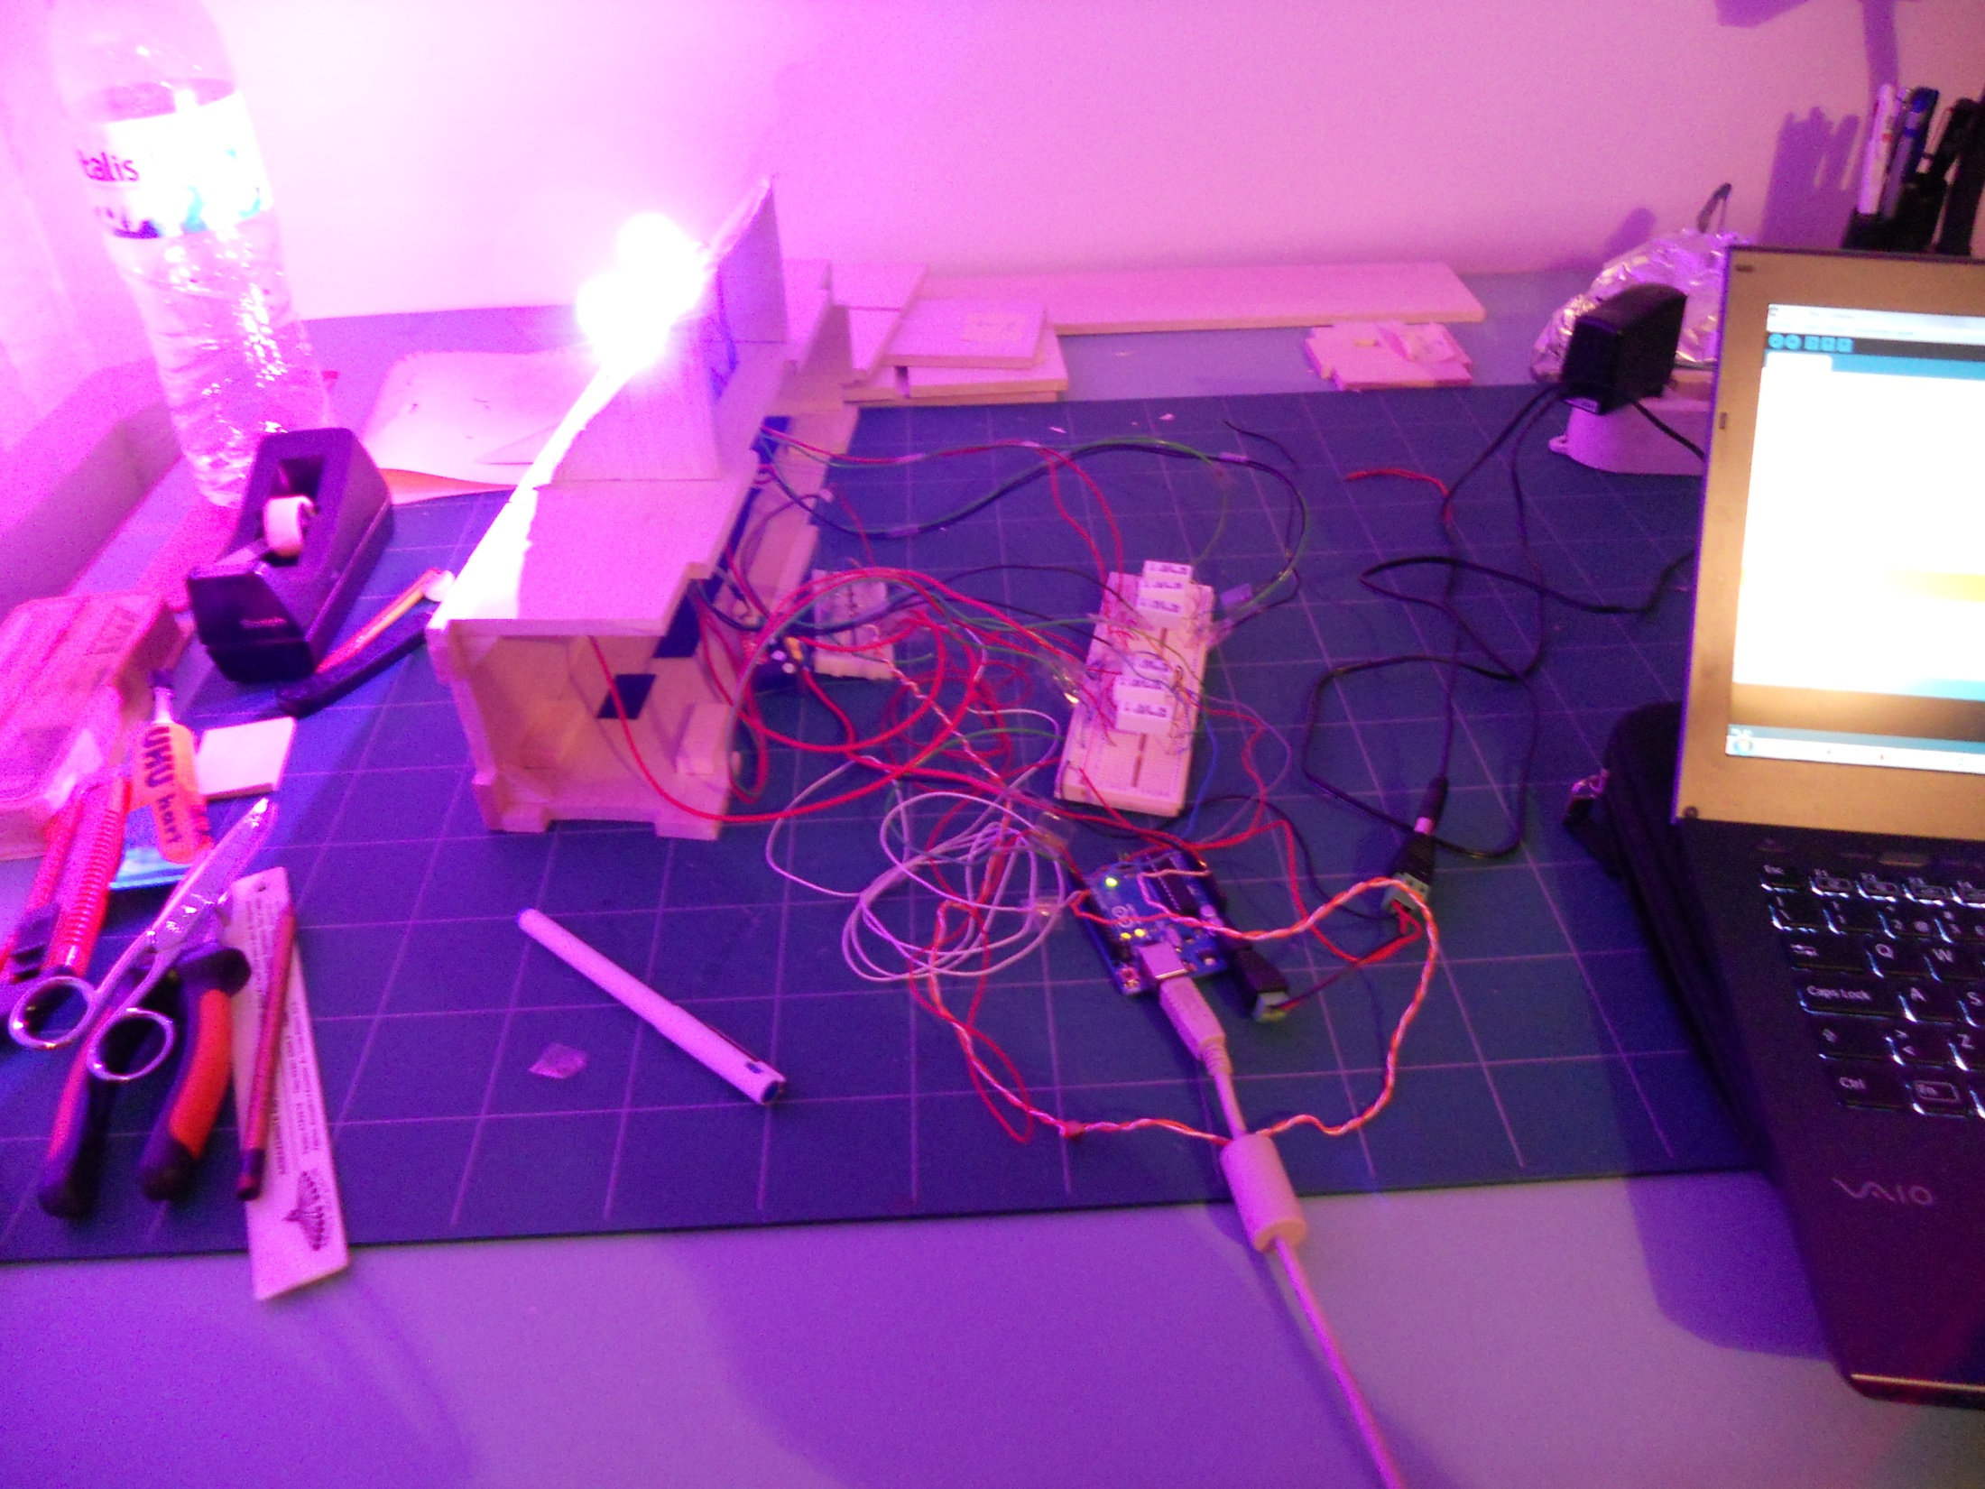
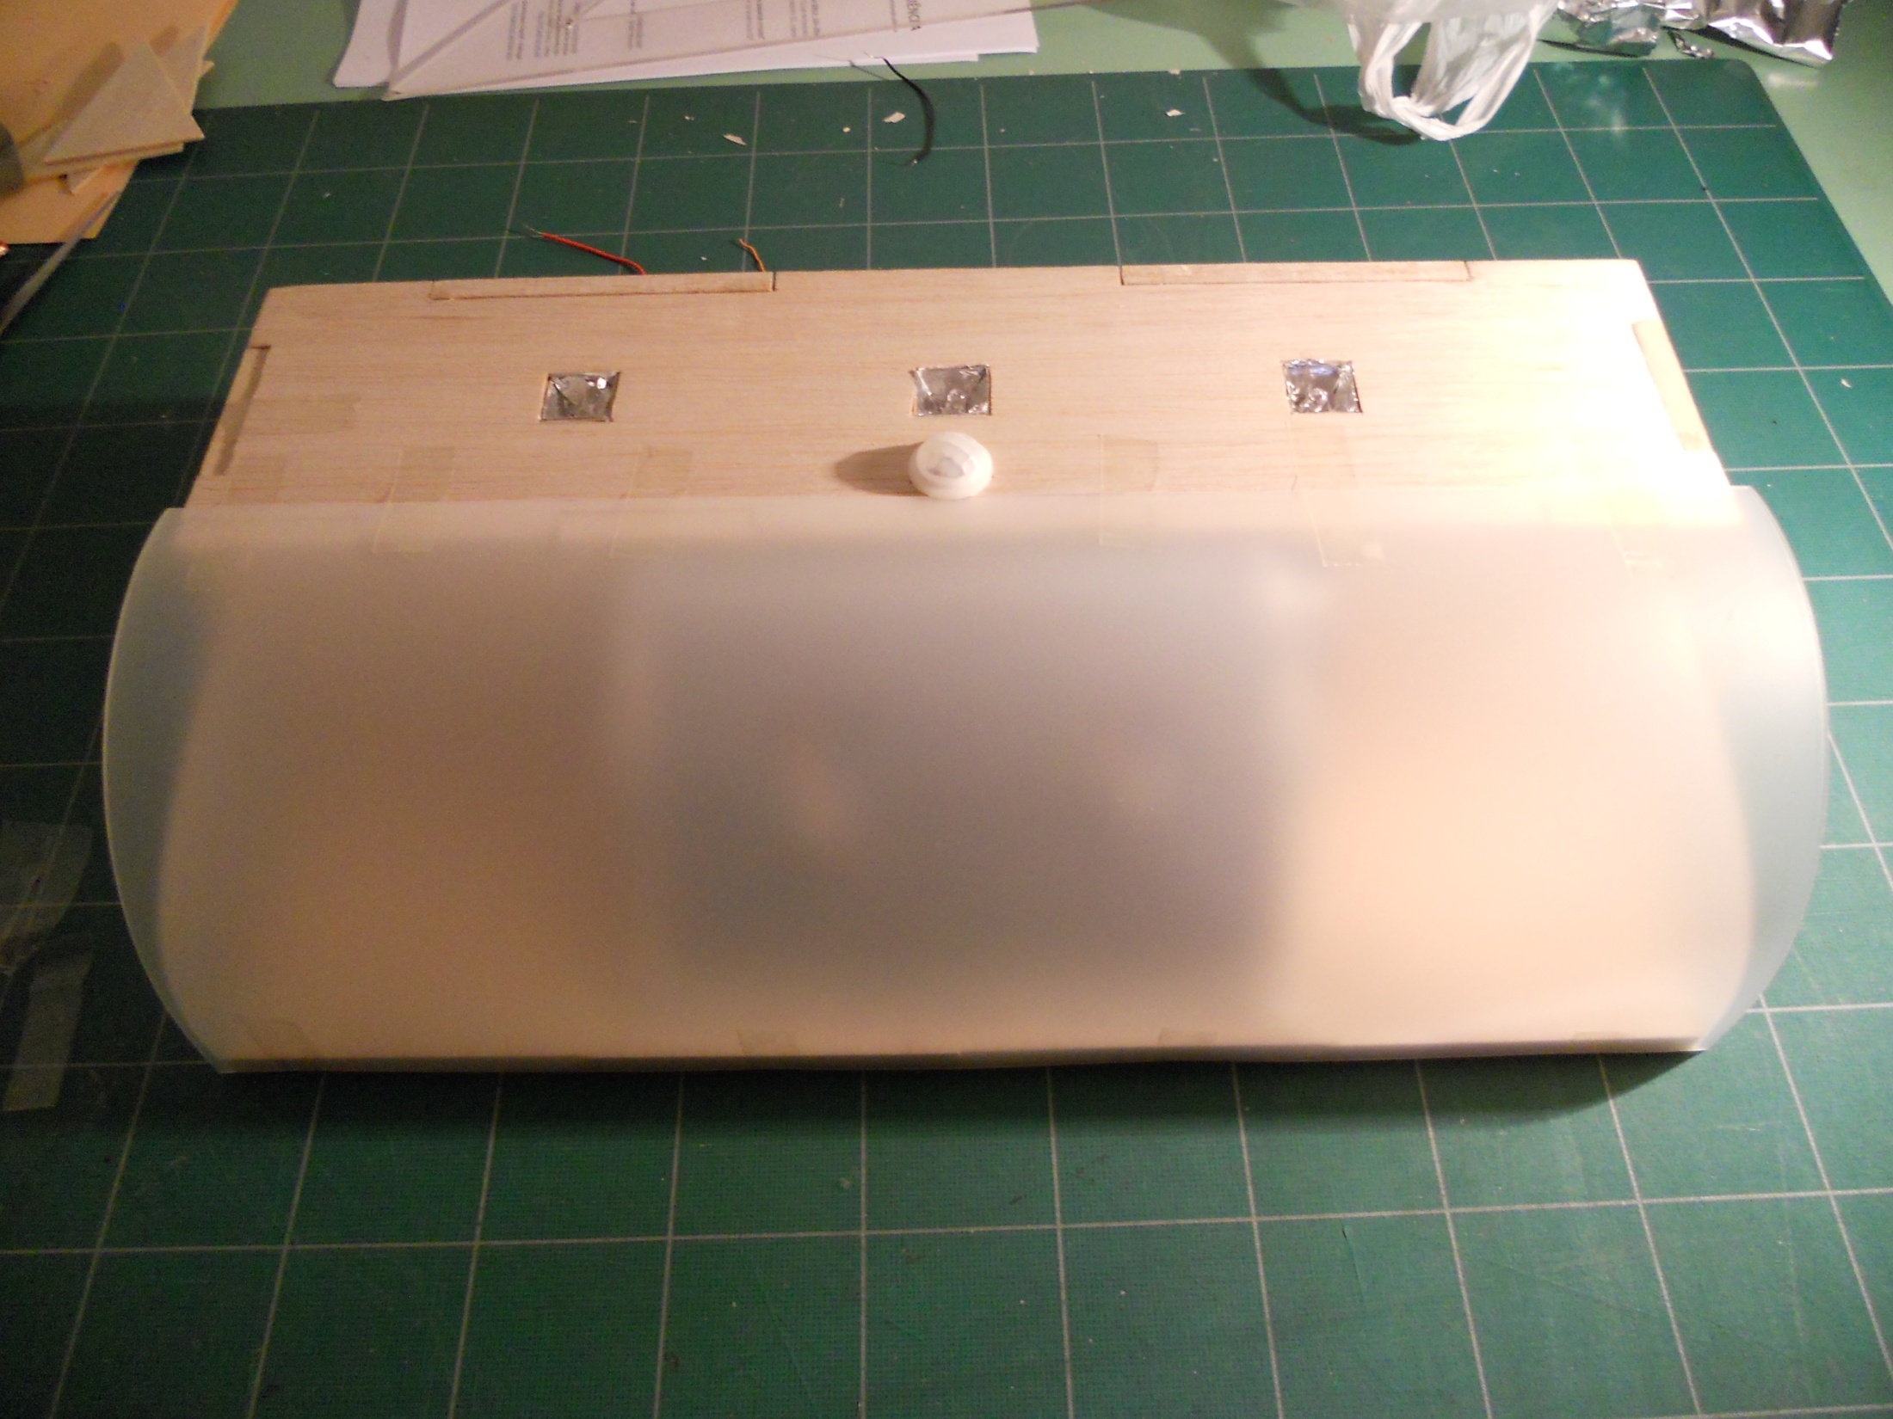
The lamp
Materials
Balsa, PVC, Jumpwires, breadboard
3 White LEDs
2 RGB LEDs
PIR sensor
Arduino microcontroller
Programmable multicolored light system
Budget ~50€
Notes:
The lamp
Just a quick note about the specifications of the material used:
-balsa and pvc for the structure
-Arduino microcontroller to help on electronics
-PIR sensor for the movement
-High brightness LEDs
The lamp is a programmed multicolored light system.
The budget spent is arround 50€. This value does not include the Arduino microcontroller. Nevertheless, the price will lower with more production.

Slide 6
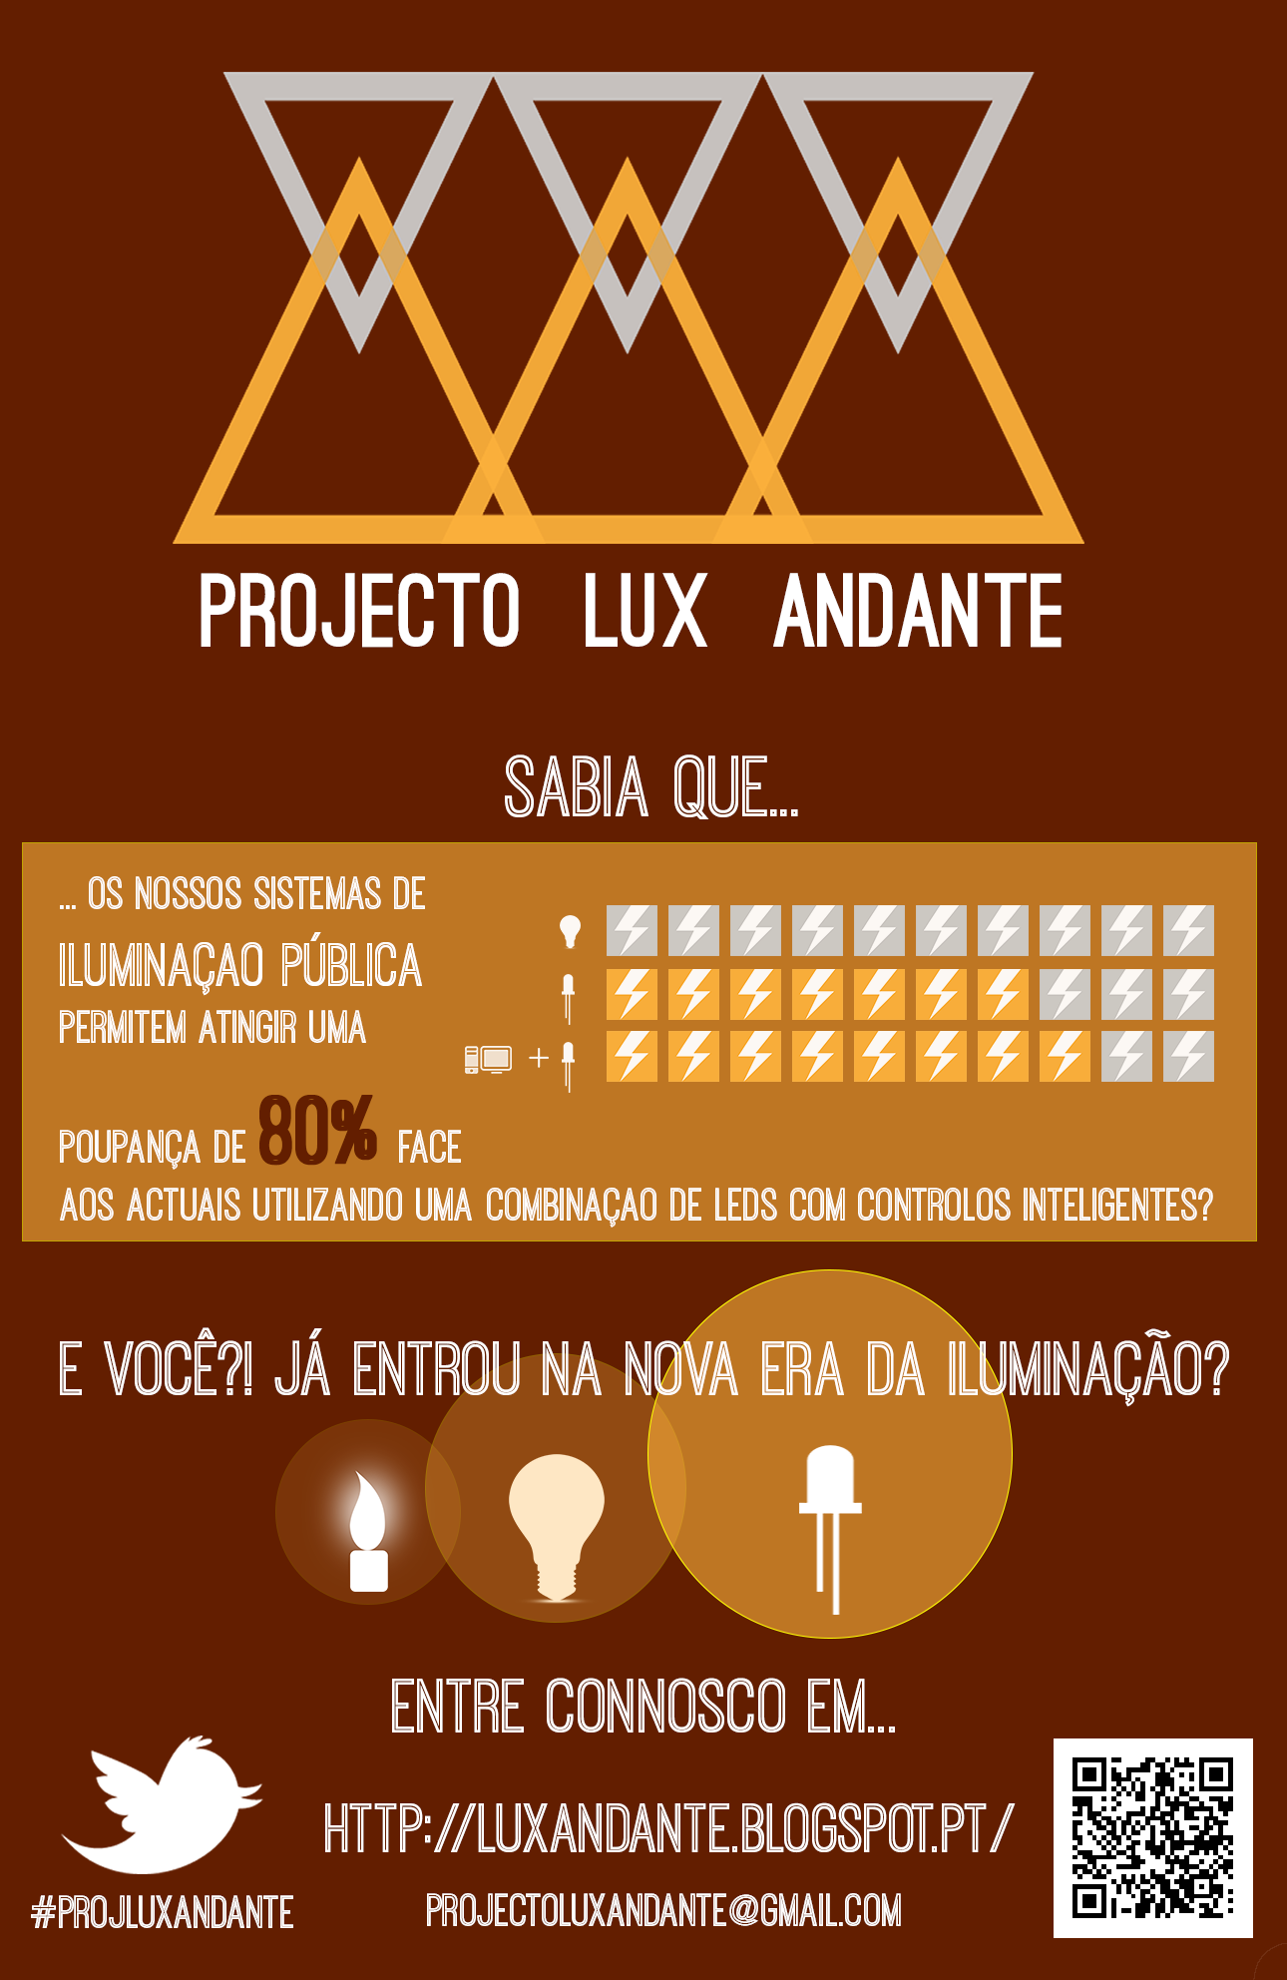
The poster
Banner
Challenging message
Educational information
Contact information
Notes:
The poster
Simple and cheaper way to pass a message.
I divided into 4 parts:
1 – Banner: Project identification
2 – Educational information: A message that can bridge some information about my project, but also to create awareness on people about the energy efficiency issue. Always with some graph/picture.
3 – Challenging message: dare people to ask questions and search for answers about this subject.
4 – Contact information: in various platforms of social media (facebook, twitter) using logos , “hashtags” and “QR tags”, but also the webpage (here is a blog) and a email adress (further, it can have a phone number and an address).

Slide 7
Some ideas
Converting table
Light Output | LEDs | CFLs | Incandescents
Lumens | Watts | Watts | Watts
450 | 4 - 5 | 8 - 12 | 40
300 - 900 | 6 - 8 | 13 - 18 | 60
1100 - 1300 | 9 - 13 | 18 - 22 | 75 - 100
1600 - 1800 | 16 - 20 | 23 - 30 | 100
2600 - 2800 | 25 - 28 | 30 - 55 | 150
Why not?
Notes:
Some ideas
I have been confronted with people, saying, “ok the LEDs can help us save some money, but which ones do I have to buy?” -> an equivalent table to inform people will be great.
One idea for a business plan/marketing issues, is to promote this kind of devices in the next “Noor” Nights at Mouraria.
NOTES: These are other ideas to complement the strategy mentioned before.

Slide 8
Questions?
Sugestions?
Merry Christmas!
Notes:
Questions?
Any suggestions?
Thank you and I wish you all a very happy Christmas!

