Slide 1
Banco Sol
An introduction to the beauty of solar energy through the joy of music
Elien Kemme, Francisco Ferreira, Malin Anderberg

Slide 2
Banco Sol
Enjoyment
Curiosity
Education
Relaxment
Idea

Slide 3
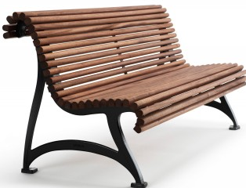
♫
♫
♫
♫
♫
♫
♫
♫ ♫ ♫
♫
♫
Info and
Music control
♫
Setup

Slide 4
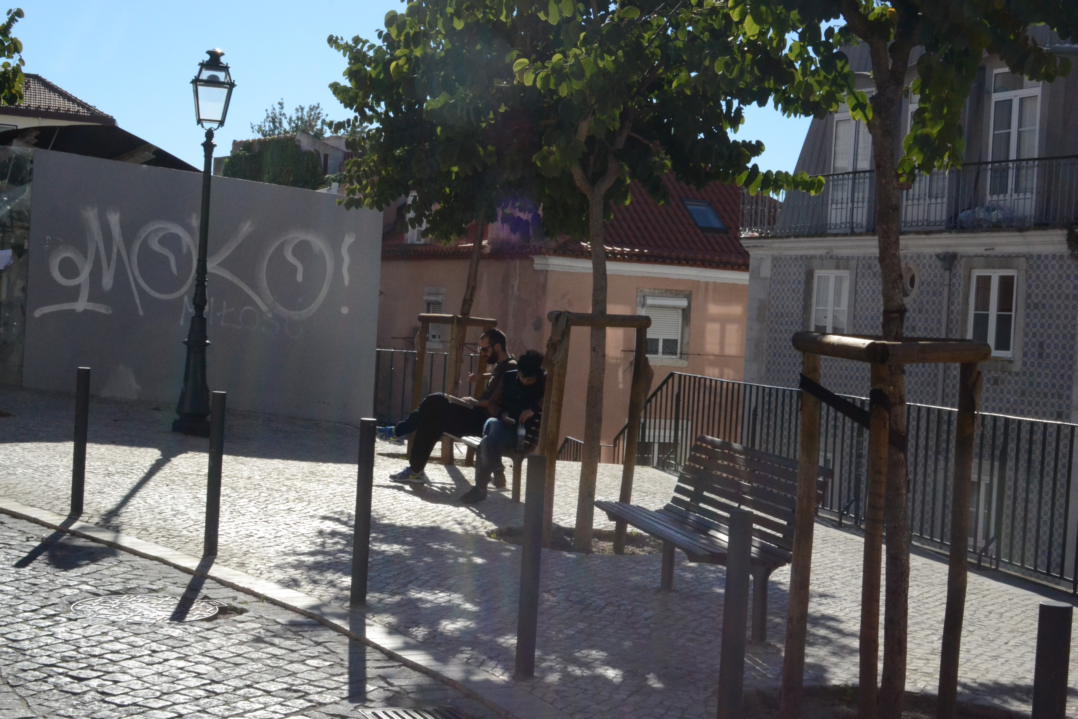
Location: Largo Rosa

Slide 5
Music+Info
Solar Energy
Interactive mode
Music selection
Mode
Person sits down
How it works

Slide 6
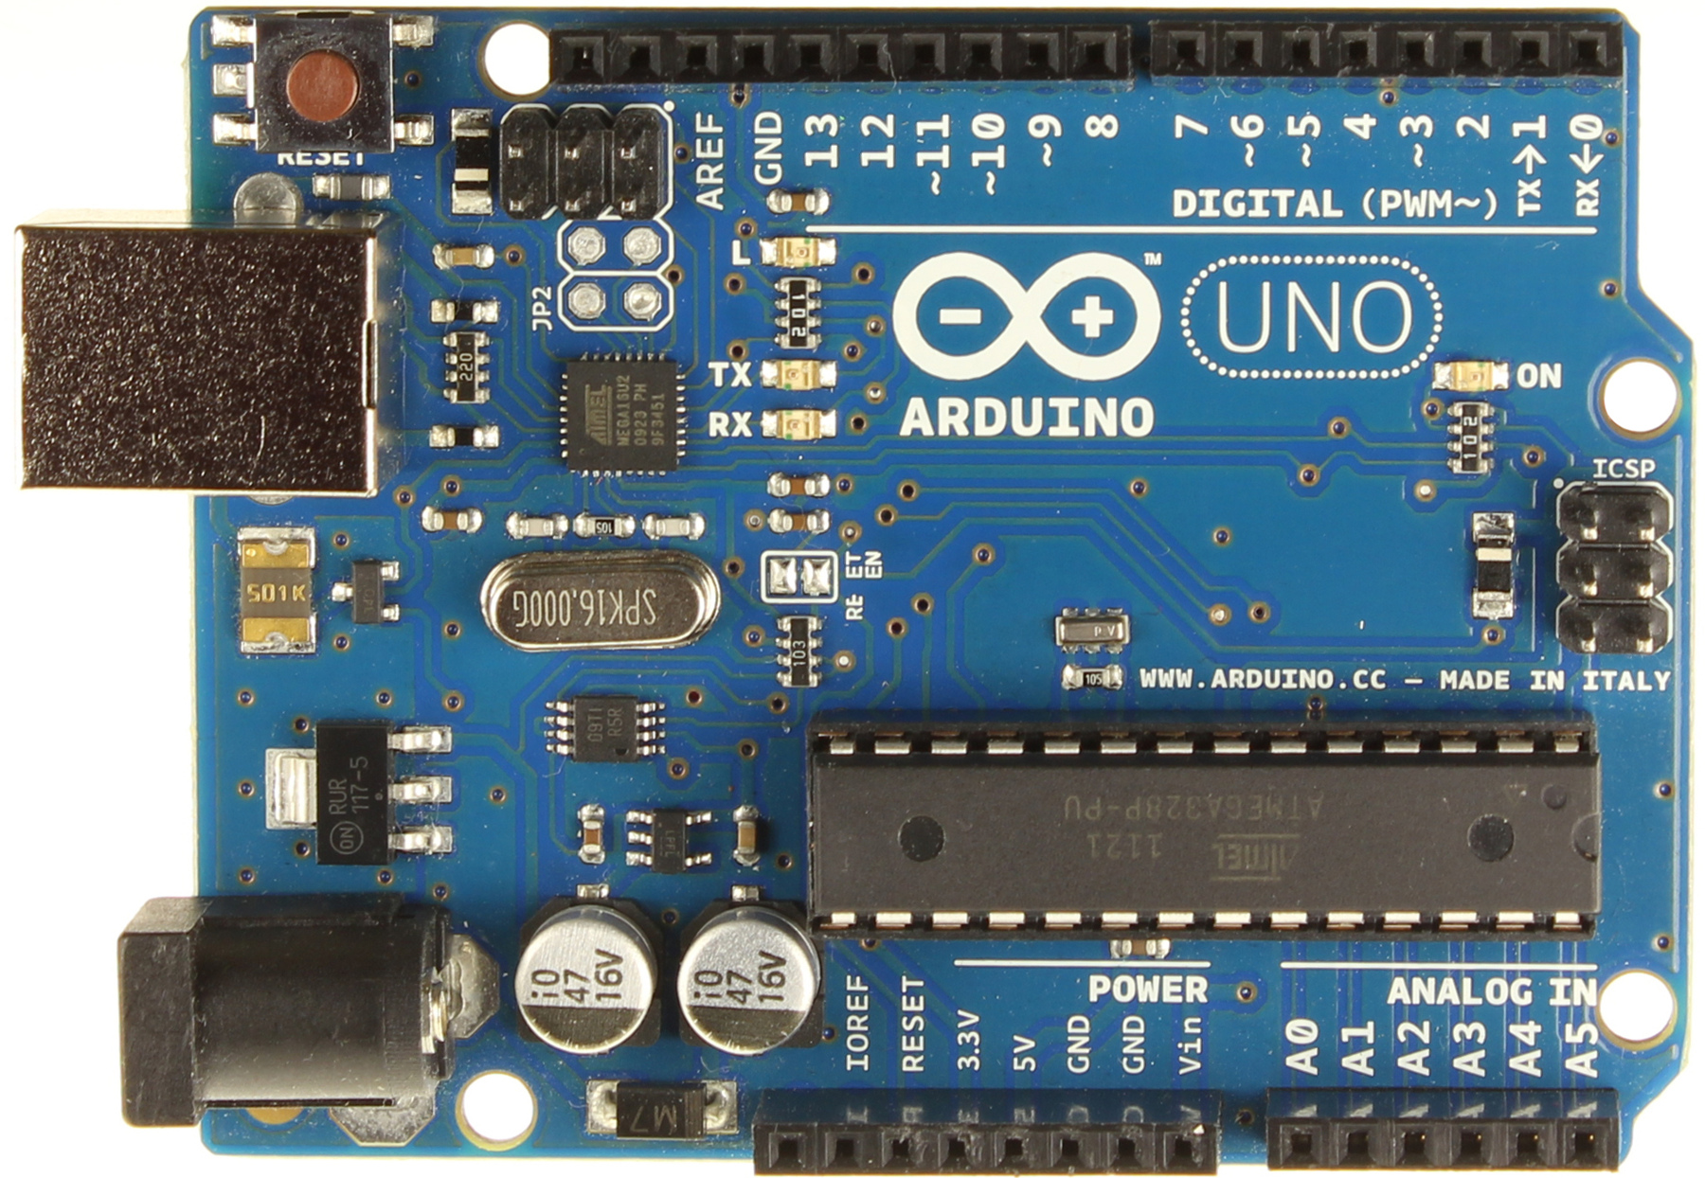
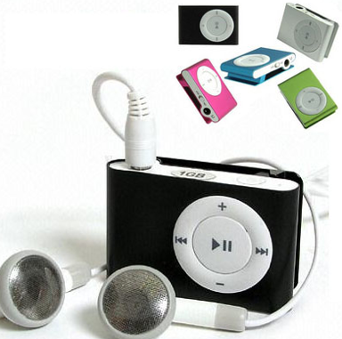
INPUT:
infrared sensor
INTERFACE:
arduino uno
OUTPUT:
mp3 player
Technical details

Slide 7
Energy Supply:
Assuming the equipment need 3 W and it will be possible to play for 8 hours a day with sun for 5 hours.
Solar Panel: 5W
Battery: 12V & 4.5 Amh
(never discharged more than 50% to increase battery life)
Technical details

Slide 8
Initial
Prototype
Final
Prototype
arduino uno: 8,5 euros (ebay)/ 20 euros on site
infra red sensor: 13 euros
Mp3: 11 euros
solar panel 5 w 12 v: 8 euros /14 euros
speakers 2w: 15 euros
Wires and resistor
batery PNY Portátil PowerPack RANGE 5600 mAh: 40 euros
Breadboard: 6 euros total 101 euros
Arduino Uno: borrowed from Guilerme (THANKS)
Breadboard: borrowed
Wires, battery :borrowed
Mp3: 11 euros
Infrared sensor: 13 euros
Speakers: borrowed
Several jaks: 4 euros total 28euros
Costs

Slide 9
Users
Steakholders
Inhabitants of Mouraria
People from all over Lisbon
Tourists
ADENE - Agência para a Energia www.solar.pt
Solar panel companies
Advertisement
Who would benefit

Slide 10
Funfacts and Poems between the songs
Information board: Panel with buttons or touch screen
Optional question game
How to inform

Slide 11
BANCO
SOL
Hello,
We hope you are enjoying your seat on Banco Sol! This is a bench developed for your convenience, so just by sitting down here you can admire the nice view together with delightful music. The bench is also here to make you aware of the fine technology of Solar photovoltaic energy and the advantages with it. Banco Sola is developed as an environmental and energy project by students at IST. If you have any questions or feedback please feel free to contact us on bancosol@gmail.com
Previous / yes
Start
Next / No
Learn More
Almost all energy on earth as its origin from the sun, it heats the earth and enable life. It creates the winds and is the driving force for the water cycle, It makes the plants grow so we can have energy in form of food and biofuels and it was even the source to all fossil fuels in the beginning.
There is two kinds of solar power we use for our homes. Solar heating, where the heat from the sun is used to heat our water, and photovoltaic energy, where the energy in the light is transformed to electric energy.

Slide 12
Choosing Music
Normal Mode
Press previous and next to select songs
Interactive Mode
Press start button to start interactive mode
Answer questions with yes or no
Switch back to normal mode by pressing start again
Previous / yes
Start
Next / No
Interaction with Interface

Slide 13
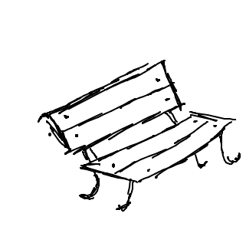
Hello,
We hope you are enjoying your seat on Banco Sol! This is a bench developed for your convenience, so just by sitting down here you can admire the nice view together with delightful music.
Choose your music down to the left and find out more about solar energy and Banco sol by clicking on the icons to the right.
What is Banco sol?
Solar Energy
Question game
Who made this possible?
BANCO
SOL
All Songs Fado Christmas Jazz Pop Sunny
Solar energy for kids
What is solar energy?
How does a solar cell work?
The story about renewable energy
Always look on the bright side of life
Desfado
Sunset and the mocking bird
Walking on Sunshine
Hard Sun
O Sol
Here comes the sun

Slide 15
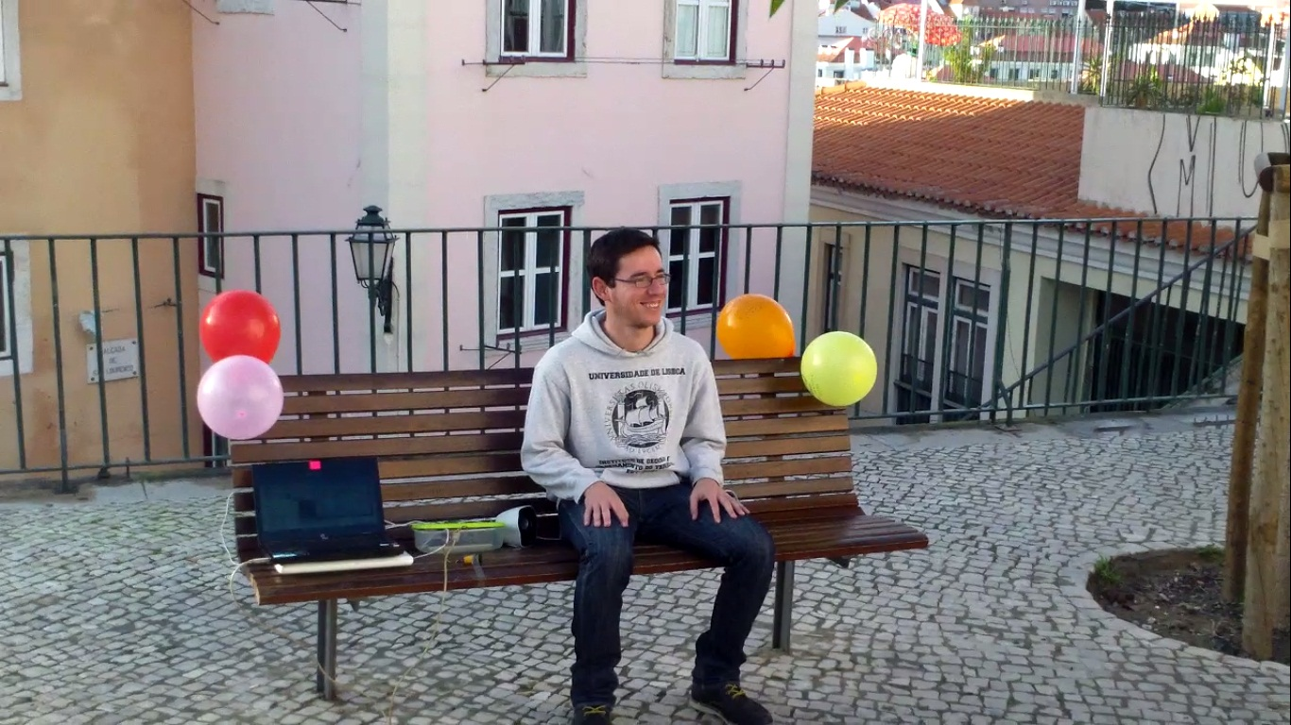
Thank you for your time.
Hope you enjoyed!

Slide 16
Banco Sol
Welcome,
Here you can understand how Banco Sol idea started.
The team wanted to developt a project in a way that people will understand and know the importance of solar panel. This idea will allow you to rest, relax and even inform you about solar energy.
The energy for the music you are listening now, it’s collected by the solar panel. It’s green and doesn’t have any costs to produce it.
The sunlight is collected and transferred by the solar panel to a batery. This is necessary because the sunlight isn’t continuous. With the help of the batery you can enjoy music everytime you seat on this bench.

Slide 17
Question game
Question game
Is solar energy na option for fossils fuels?
Yes
No

Slide 18
Solar energy
Almost all energy on earth as its origin from the sun, it heats the earth and enable life. It creates the winds and is the driving force for the water cycle, It makes the plants grow so we can have energy in form of food and biofuels and it was even the source to all fossil fuels in the beginning.
There is two kinds of solar power we use for our homes. Solar heating, where the heat from the sun is used to heat our water, and photovoltaic energy, where the energy in the light is transformed to electric energy.
Solar Panel
Solar Heater

